Slide 1
TOPIC A4:
MACHINE LEARNING
LESSON A4-7
ETHICS

Slide 2
AGENDA
Warm up
What is an ethics question
The nine issues
Bias in training data
Online communication
Rules? Who needs ‘em?
The Discuss command term
Lab
WHAT U NEED 4 LESSON
Guided Notes
An opinion
ur hedz

Slide 3
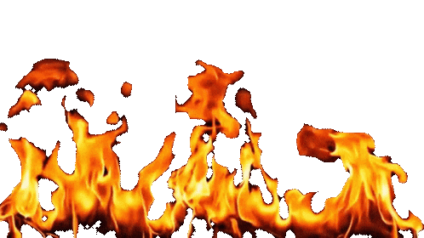
WARM UP QUESTION
(a) State what a leaf node in a decision tree contains [1]
(b) A tree and a neural network are equally accurate on a hospital's data. State one reason the hospital might choose the tree [1]
(c) A tree gets all 8 of its training patients right. State one reason that might be a problem [1]
→ Notes Q1 (a), (b), (c)

Slide 4
WARM UP ANSWER
(a) A category. It is the prediction the tree gives once the questions stop.
(b) A tree can be read. The hospital can show a patient why the decision was made.
(c) It may have overfitted – even if it’s perfect on its own data set it might not work for a new patient

Slide 5
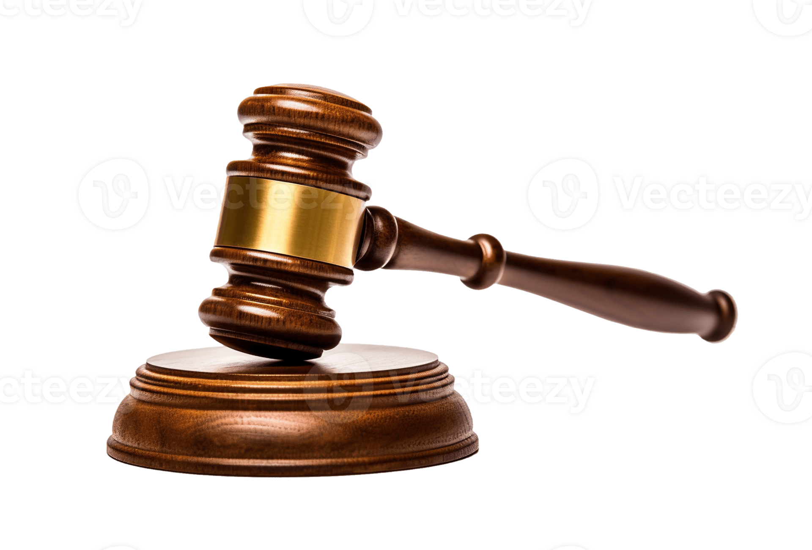
WHAT IS AN ETHICS QUESTION?
An ethics question is not a legal question, nor a technical question
A legal question asks whether something is ‘allowed’
A technical question asks whether something ‘works’
An ethics question asks four things: who is affected by the decision, who made the decision, who benefits from the decision, and who pays the cost of the decision.
A system can be legal, work perfectly, and still be the wrong thing to build.

Slide 6
WHAT IS AN ETHICS QUESTION
Machine learning raises these questions more often than ordinary software
  It learns from data about real people, so the data itself can be the problem
  It makes decisions at a scale that a person can’t really oversee
  Its reasoning is often not readable, so mistakes are hard to find and hard to appeal
Most of our issues arise from these categories

Slide 7
THE NINE ISSUES
The guide names nine. You need all nine by name and a definition for each.
Accountability - somebody can be named as responsible for what the system does
Algorithmic fairness - the system works equally well for different groups of people
Bias - the outputs favor or disadvantage a group, usually reflecting the training data
Consent - people agreed to their data being used and knew what it would be used for
Environmental impact - the energy and water used to train and run the model

Slide 8
THE NINE ISSUES
Privacy - people keep control of information about themselves
Security - the data and the model are protected from theft and tampering
Societal impact - what changes in how people live once the system is used at scale
Transparency - you can find out what the system does and why it decided what it did
These keywords are essential, and the IB wants to see you use the words, not just the definitions on the exam
→ Notes Q2 – try to brainstorm an example of each on your own
  Maybe you’ve seen some from the tech news…?

Slide 9
THE NINE ISSUES
Accountability: a bank refuses a loan, but nobody at the bank can explain why or overrule the choice
Algorithmic fairness: a face recognition system is accurate for some skin tones and not others
Bias: a hiring model prefers the kind of applicant the company has always hired
Consent: photographs taken from public profiles are used as training data
Environmental impact: one training run uses the same amount of electricity as 1,000 homes use in a year

Slide 10
THE NINE ISSUES
Privacy: a fitness app's location data shows where each of its users lives
Security: a leaked medical model lets an attacker recover patient records from it
Societal impact: a video feed tuned for watch time changes what millions of people believe about an election
Transparency: a school cannot say why its model predicted a student would fail
Lots of examples include, like, 3 or 4 of these!
  There are a… lot of issues!

Slide 11


BIAS IN TRAINING DATA
A model learns the pattern in its training data
  In fact, that’s all it does
If the training data records unfair decisions, the model learns to make unfair decisions.
  Let’s say a company trains a hiring model on ten years of its own applications, labelled with who was hired
  Over those ten years the engineering team hired mostly men.
The model now scores applicants higher when they resemble the people already hired (y’know – men)
Nobody hard coded a rule about gender, and yet it developed from the training data

Slide 12
BIAS IN TRAINING DATA
The obvious fix is to delete the gender field and train again, right?
  This might not work
Other fields carry the same information: a women's college, a typically women’s sport, or a two-year employment gap
A field that stands in for a protected one is a proxy variable – so those things above are proxies for womanhood
  Removing one column does not remove the information if three other columns rebuild it
This is part of why feature selection matters in machine learning, we don’t want to include biases

Slide 13
BIAS IN TRAINING DATA
Bias can get into training data three ways
Sampling bias - the data does not cover everyone the model will be used on
  A skin cancer model trained only on light skin
Labelling bias – multiple people who applied labels have different standards
  One moderator's “abusive” label might be fine to another moderator
Historical bias - the data is accurate, but it was recorded in an ‘unfair’ world
  The hiring record of mostly men is correct after all
  Incredibly difficult to correct

Slide 14
BIAS IN TRAINING DATA
If the model rejects an applicant it shouldn’t have, who should be held accountable?
The engineer wrote no rule about gender anywhere in the code.
The company supplied ten years of its own decisions as the training data.
The manager read the output and did not question it.
Accountability means that question has an answer before the system is used, not after.
→ Notes Q3 (a), (b) and (c)

Slide 15
ONLINE COMMUNICATION
Social media and video sites use a model to choose what’s recommended to you
  It is usually tuned to increase engagement: time spent, clicks, shares
So the model learns what holds attention, and anger tends to hold attention quite well
  Accurate content tends to lose out to outrageous content
    That is how misinformation spreads so fast on the modern internet

Slide 16
ONLINE COMMUNICATION
The guide lists four concerns for this area:
Bias: moderation models learn from human decisions, so some speech dialects get flagged as abusive far more often than others
Online harassment: a system tuned for reach spreads abuse as efficiently as it spreads anything else
Anonymity: it protects whistleblowers and victims, and it shields harassers, so some good things come from this and some bad things
Privacy: what you watch and where you pause is collected, regardless of if you post yourself
→ Notes Q4 (a) and (b)

Slide 17

RULES? WHO NEEDS ‘EM?
Ethical guidelines are written in reference to technology that exists at the time the guidelines are written
  Often, new technology creates situations the old rules do not describe
Privacy law assumes a camera is a visible object that somebody is pointing at you
  Smart glasses that record all day break that assumption without technically breaking the law
So guidelines have to be reviewed as the technology changes

Slide 18

RULES? WHO NEEDS ‘EM?
Here’s what the IB thinks are the technologies to ‘watch’:
Quantum computing: encryption today assumes large numbers cannot be factored quickly
  A quantum computer could, which may expose data stored now
Augmented reality: glasses record everybody the wearer looks at, none of them able to effectively consent
Virtual reality: digital harassment can obviously be felt physically, but most of our rules are just for text-based harassment
Pervasive AI: do I even need to talk about this one

Slide 19
RULES? WHO NEEDS ‘EM?
It’s also important to consider what could be impacted by these technologies
Society: how has society changed with the advent of the personalized algorithm?
Individual rights: Who do you go to if you want to overturn the decision of an AI algorithm?
Privacy: more devices collecting more data, and consent to collect that data being impossible to deny nowadays
Equity: not everybody can pay for Claude Pro, some people have to use ChatGPT Free - that gap is the digital divide.
→ Notes Q5 (a) and (b)

Slide 20
THE DISCUSS COMMAND TERM
Every question in A4.4 uses ‘Discuss’
Discuss means: give arguments on more than one side, weigh them, then reach a conclusion
A list of issues with no weighing and no conclusion only scored you about half marks
A structure that works: name the issue, say what happens because of it, give the other side, then conclude
  Bing bang boom boom
Make sure you use the vocabulary terms
  Say transparency, not “you cannot tell what it is doing”

Slide 21
THE DISCUSS COMMAND TERM
Here’s a potential example: Susie is a foreign pen pal and you have to write her a welcome letter
  Do you write it, or does a chatbot?
For the chatbot: it will be better written, and a clear letter is easier for her to read
Against: she was not told, so she cannot judge what she is holding
  transparency and consent
Conclusion: the point of the letter was the time somebody spent on it, so generating it removes the thing it was for
Both sides, named issues, a conclusion, heck yeah

Slide 22
LAB
→ Notes Q6 and Q7
Q6 A hospital buys a system that reads chest scans and flags likely disease. It was trained on scans from one country and the hospital is in another. Discuss the ethical implications of using it. [6]
Q7 Training one large model uses the electricity 1,000 homes use in a year. Discuss whether companies should have to publish that figure. [3]

Slide 23

VOCABULARY TO REMEMBER
Accountability
Algorithmic fairness
Bias
Sampling bias
Labelling bias
Historical bias
Consent
Environmental impact
Privacy
Security
Societal impact
Transparency
Proxy variable
Misinformation
Anonymity
Equity
Digital divide

